Slide 1

الشركة الوطنية لخدمات الملاحة الجوية
الإدارة العامة لحاسبات أنظمة المراقبة الجوية

Slide 2


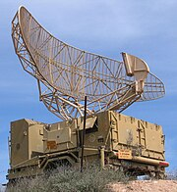

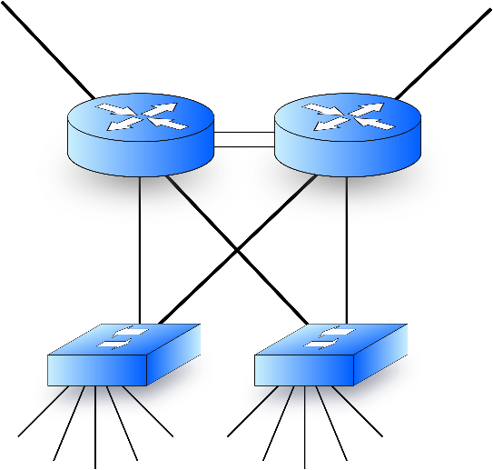

Objectives
Education VS Work
Air Navigation
Network Hints
Linux شوية

Slide 3
Agenda
Day 1 | Introduction to the course Air navigation Air Traffic Control Data processing overview Radars and sensory data processing Networking hints Linux Overview Linux distributions Linux installation | ATC air situation display Servers and racks

Slide 4
Agenda
Day 2 | Sensory data processing review Flight data processing Track – flight plan coupling Monitoring aids Safety net Basic Linux commands | Tower, approach and area ATC air situation display (alerts)
Day3 | Hostnames and /etc/hosts Redundancy Servers vs workstations Problem troubleshooting Regular Expressions Questions

Slide 5
الإدارة العامة لحاسبات أنظمة المراقبة الجوية
2024
Osama Salaheldin

Slide 6

Air Traffic

Slide 7


Air Traffic – Cont.

Slide 8
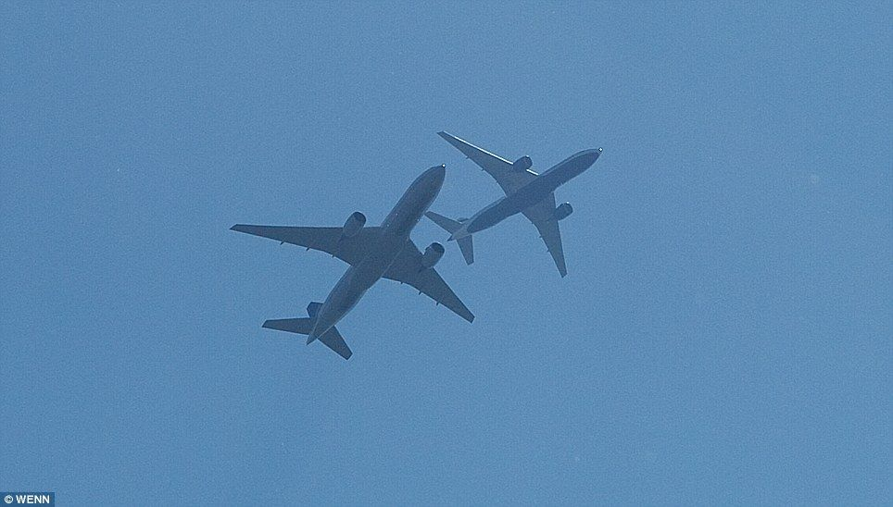
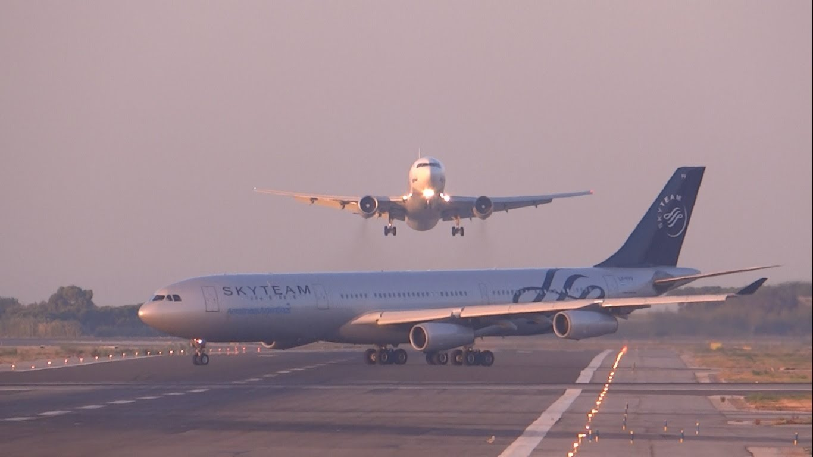
Air Traffic – Cont.

Slide 9

Air Traffic Control (ATC)

Slide 10
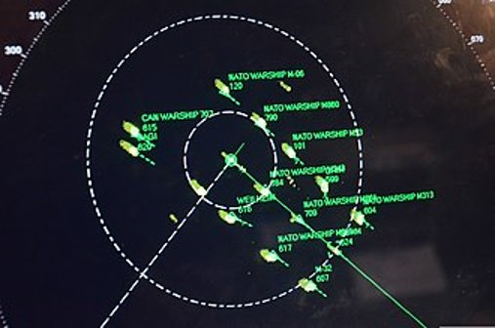
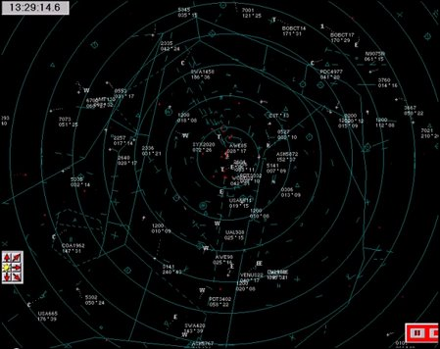
Air Traffic Control (ATC) - Radar Display Air situation

Slide 11
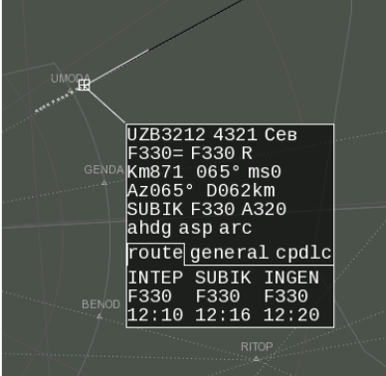
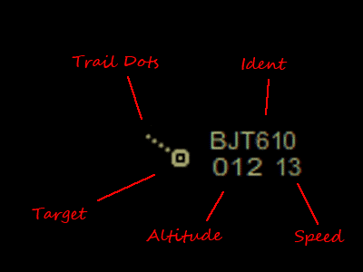
Air Traffic Control (ATC) - Radar Display Track Label

Slide 12

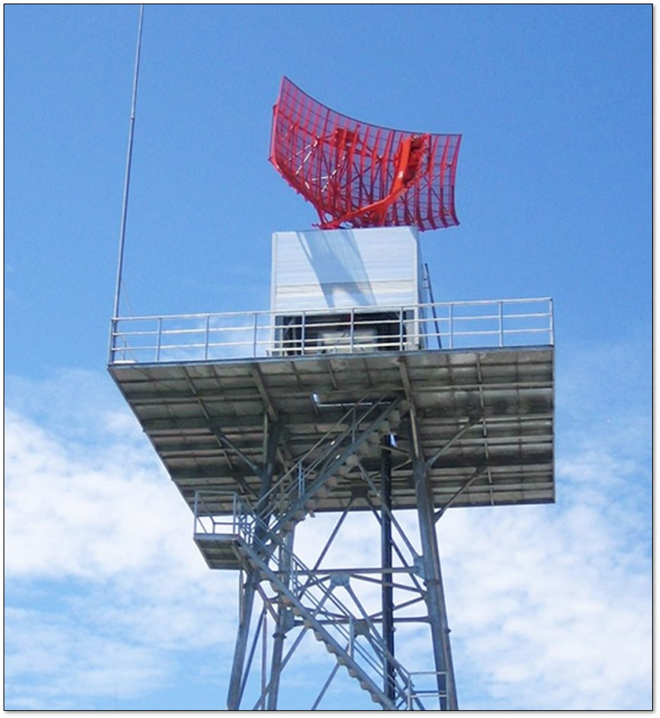
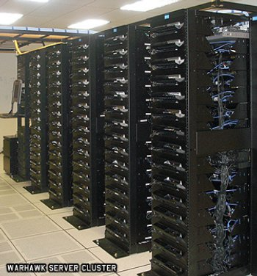
Air Traffic Control (ATC) - Radar Display Track Label
Data processors

Slide 13

Air Traffic Control
Air Traffic Control (ATC) - Radar Display Track Label

Slide 14
Air Traffic Control (ATC) - Radar Display Track Label
Data processors

Slide 15
External Interfaces
Air Traffic Control (ATC) - Radar Display Track Label
Data Sources

Slide 16
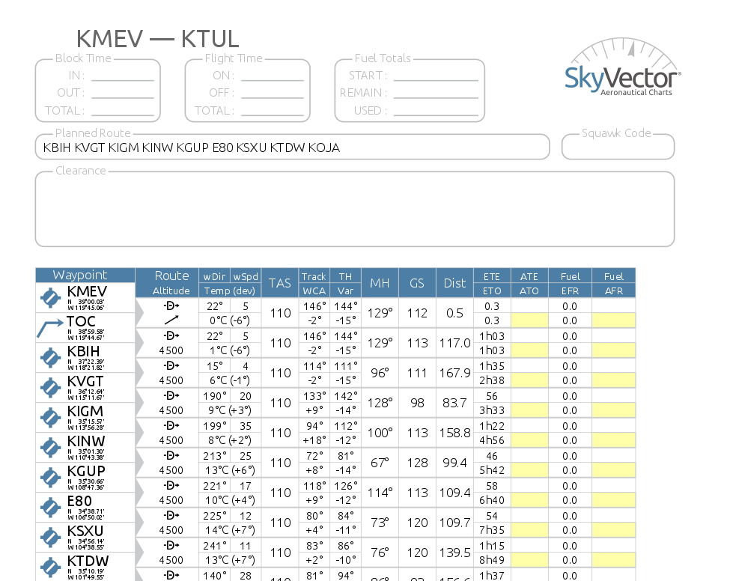
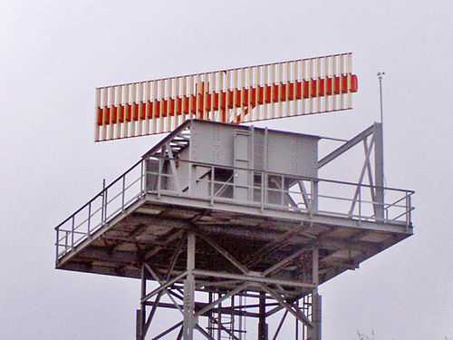
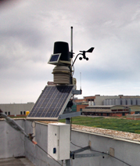
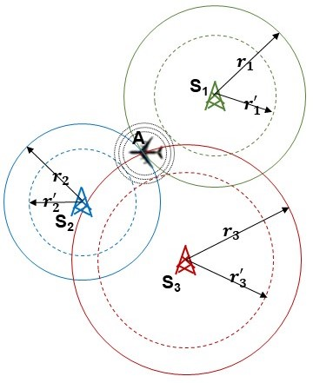

External Interfaces – Data Sources
Sensors
Secondary Radars
Primary Radars
Flight Plans
Data processors
ADSB
Meteo data
WAM

Slide 17
External Interfaces – Data Sources – Sensors
Primary Radars
Secondary Radars
ADSB
WAM

Slide 18
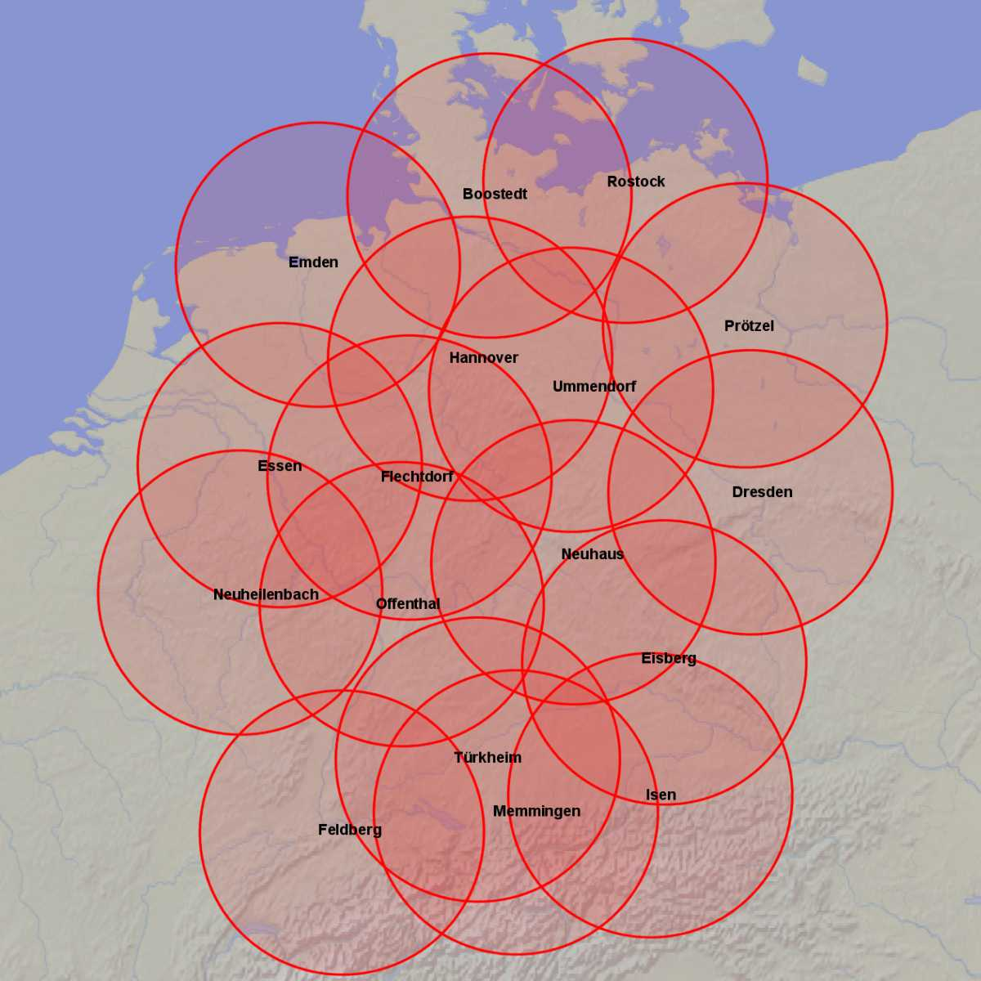
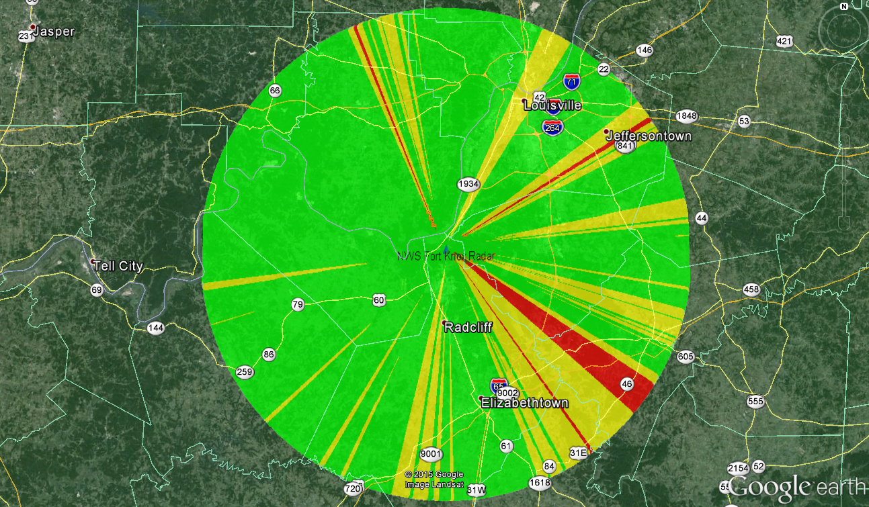
External Interfaces – Data Sources – Sensors - Coverage

Slide 19
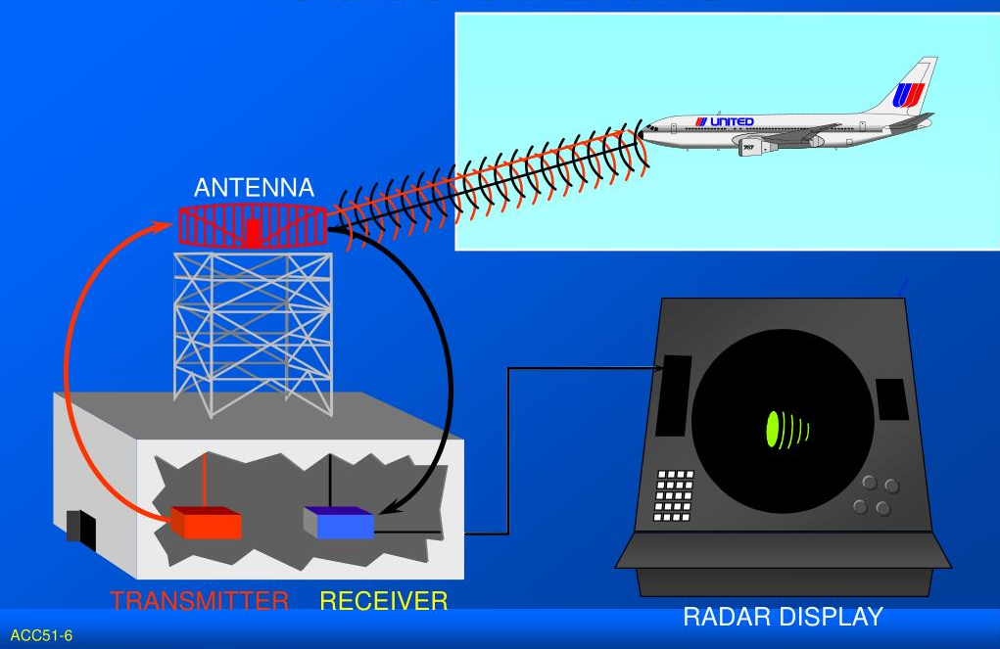
External Interfaces – Data Sources – Sensors
Primary Radar

Slide 20
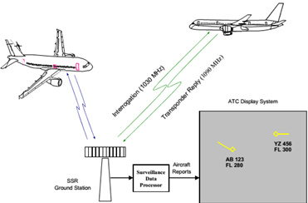
External Interfaces – Data Sources – Sensors
Secondary Radar

Slide 21
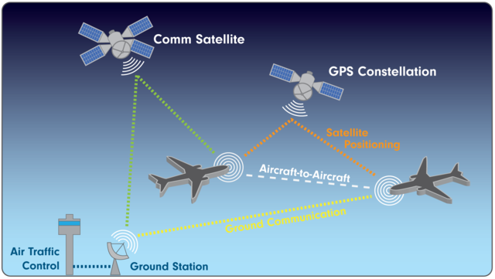
External Interfaces – Data Sources – Sensors
Automatic Dependent Surveillance–Broadcast (ADS-B)

Slide 22
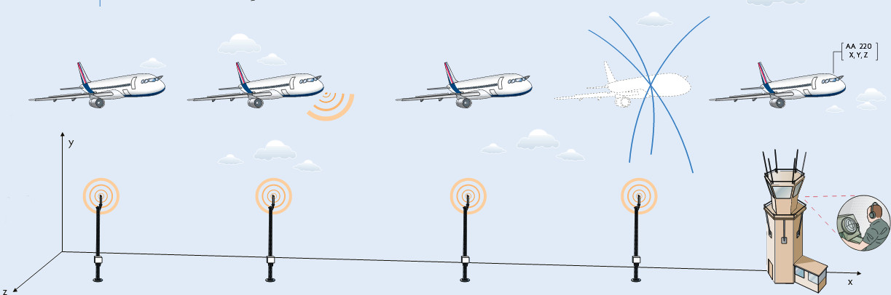
External Interfaces – Data Sources – Sensors
Wide-Area Multi-lateration

Slide 23
External Interfaces – Data Sources – Sensors (Summary)
Primary Radars
Secondary Radars
ADSB
WAM
Location (lat-long)
Height
SSR Code
Call sign
ICAO Code
N250321 E0312300
3000 feet
3245
MSR204
AABBCC
Location (lat-long)

Slide 24
Sensory Data Processing

Slide 25
Sensory Data Format
ASTERIX

Slide 26
Sensory Data Processing - ASTERIX
All Purpose Structured EUROCONTROL Surveillance Information Exchange
Defining the low level implementation of a data format used for exchanging surveillance-related information in ATM applications
ASTERIX

Slide 27
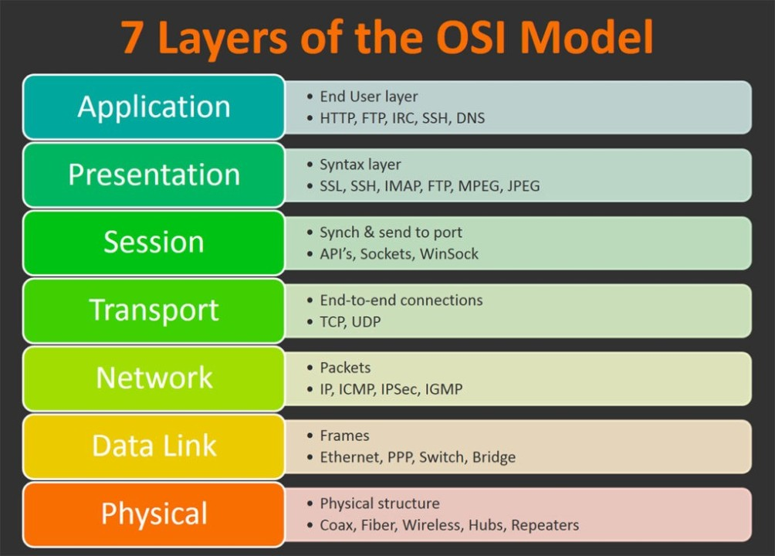
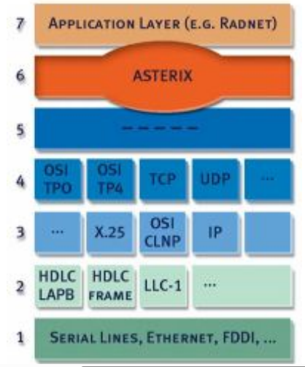
Sensory Data Processing - ASTERIX

Slide 28
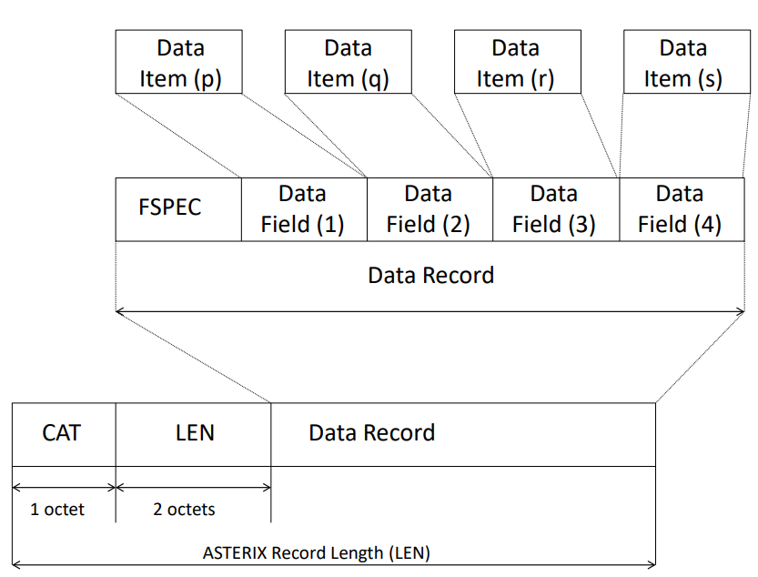
Sensory Data Processing – ASTERIX – Contd.

Slide 29
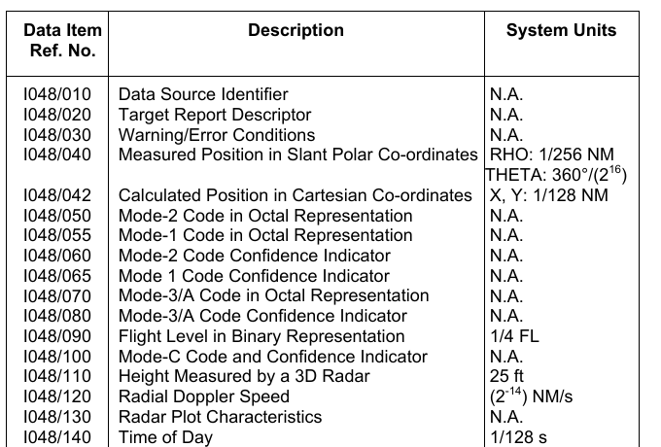
Sensory Data Processing – ASTERIX – Contd.

Slide 30
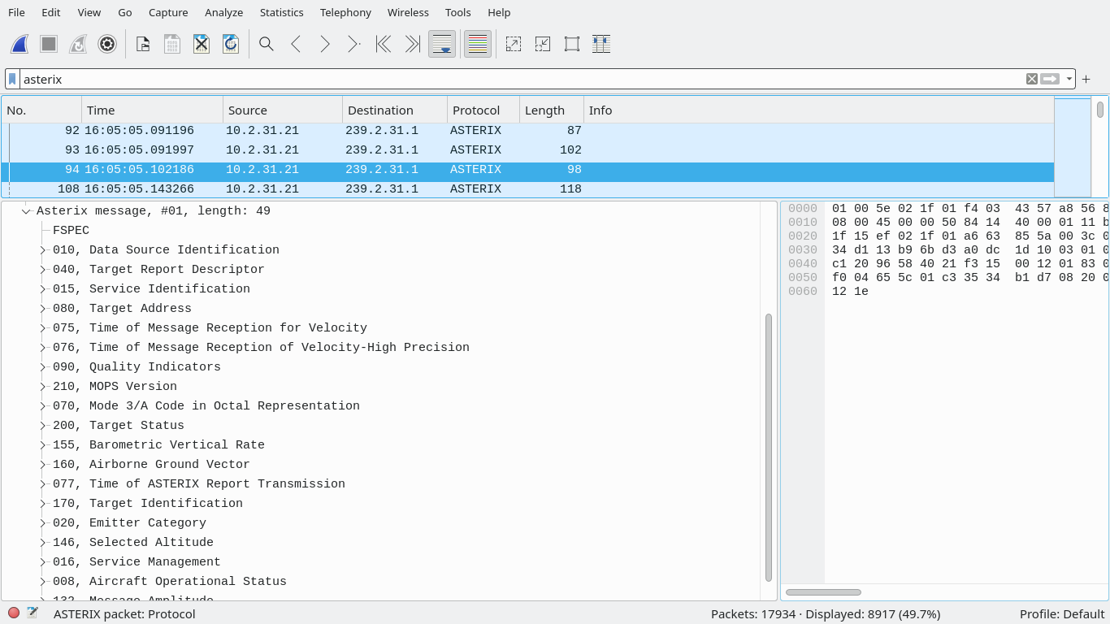

Slide 31
Sensory Data Format
Data Fusion
ASTERIX

Slide 32
Data Fusion
Sensory Data Processing

Slide 33

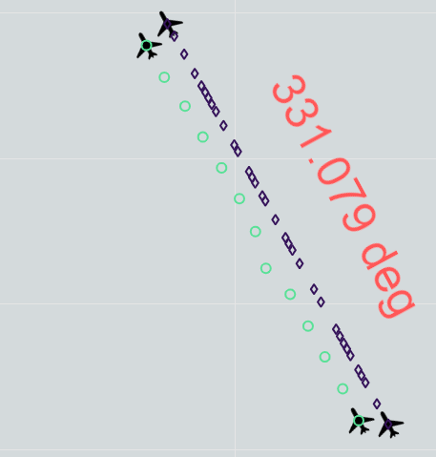

Sensory Data Processing – Data Fusion
Sensory Data Processor (SDP)
SDP

Slide 34
Sensory Data Processing – Data Fusion – Cont.
Primary Radars
Data Fusion
O
+
+
◻
O
Secondary Radars
◇
+
ADSB
Sensory Data Processor (SDP)
O
+
O
◻
+
+
O
+
◻
MLAT (WAM)
O
◇
+
+
◇

Slide 35
Sensory Data Processing – Data Fusion – Cont.
O
+
Primary Radars
Data Fusion
Secondary Radars
◻
O
◇
◻
+
O
ADSB
+
Sensory Data Processor (SDP)
+
MLAT (WAM)
◇

Slide 36
Sensory Data Processing – Data Fusion – Cont.
◇
◻
+
O
Primary Radars
Data Fusion
Secondary Radars
ADSB
◇
◻
+
O
Sensory Data Processor (SDP)
◇
◻
+
MLAT (WAM)
O

Slide 37
Data Fusion
Sensory Data Processing
Track Initiation
Sensory Data Format

Slide 38
Sensory Data Processing – Track Initiation
Time 0
Track 0
Time 1
Data Fusion
Track 2?
Time 2
Sensory Data Processor (SDP)
Track 1

Slide 39
Sensory Data Processing – Track Initiation – Cont.
Detecting the presence of new aircraft tracks from the radar measurements
Plot that doesn't belong to an existing track
Wait for the plot in subsequent scans
Initiate a new track
global nearest neighbor
probability data association algorithm

Slide 40
Sensory Data Processing – Track Initiation – Cont.
Time 0
Track 0
Time 1
Data Fusion
Time 2
Track 2
Time 3
Time 4
Sensory Data Processor (SDP)
Track 1

Slide 41
Sensory Data Processing – Track Update
Validation:
Uniform motion
Uniform speed change
Standard turn
Track
Track Management (Update and Deletion)
Likelihood function:
Distance bet. Plot and Track
SSR Code
AC 24-bit address

Slide 42
Sensory Data Processing – Track Validation – Turn
Time 0
Time 1
Data Fusion
X
Time 2
Track 2
Time 3
Time 4
Time 5
Sensory Data Processor (SDP)
Rejected: wrong turn

Slide 43
Sensory Data Processing – Track Validation – Speed
Time 0
Time 1
Data Fusion
Time 2
Track 2
Time 3
X
Time 4
Time 5
Sensory Data Processor (SDP)
Rejected: wrong speed

Slide 44
Sensory Data Processing – Track Likelihood
Time 0
Time 1
Data Fusion
Time 2
Track 2
X
Time 3
Time 4
Rejected: Mismatching SSR Code and AC address
Time 5
Sensory Data Processor (SDP)

Slide 45
Sensory Data Processing – Track Cancellation
X
Time 0
Track 2
Track 0
Time 1
Data Fusion
Time 2
Time 3
Time 4
Time 5
Sensory Data Processor (SDP)
Time 6
Track 1
Rejected: wrong speed

Slide 46
Sensory Data Processing – Summary
Sensory data decoding (ASTERIX)
Data fusion
Track Initiation
Track Update and Validation
Track Cancellation

Slide 47

Flight Data Processing

Slide 48
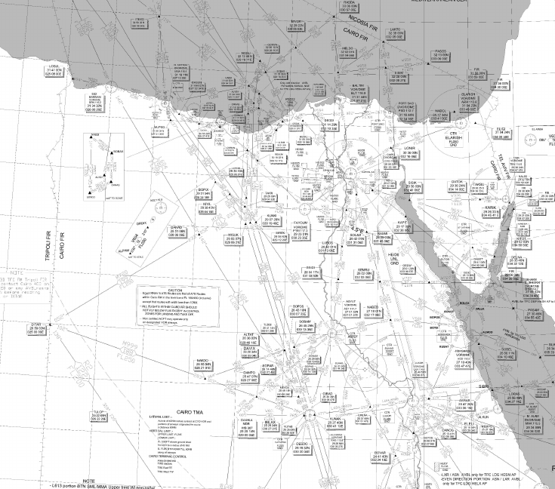
Flight Data Processing – Air Field Definition: Air Routes

Slide 49
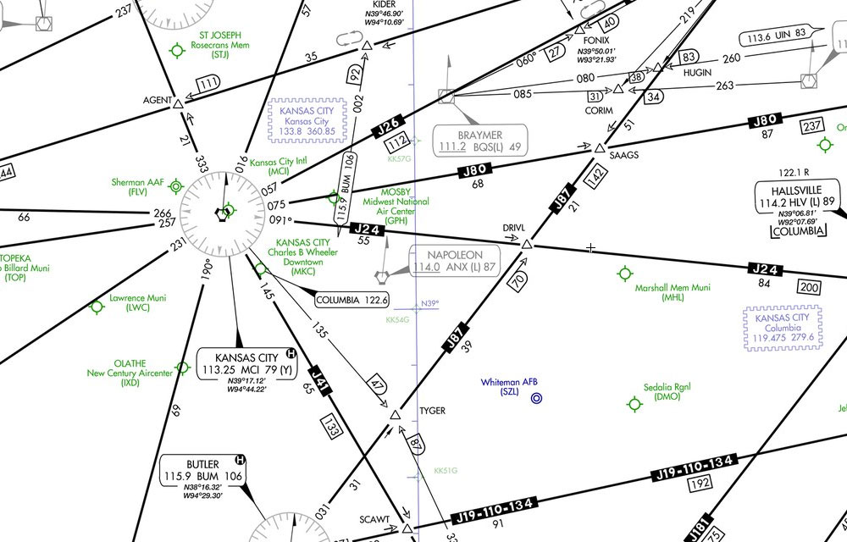
Flight Data Processing – Air Field Definition – Air Routes – Cont.

Slide 50
Flight Data Processing – Air Field Definition – Air Routes – Cont.

Slide 51
Air Traffic Control (ATC) - Radar Display Track Label (Rvstd.)

Slide 52
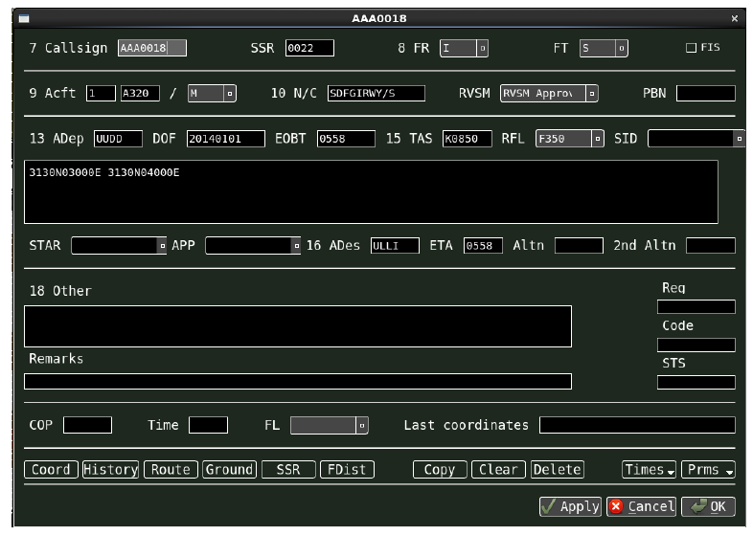
Air Traffic Control (ATC) - Radar Display Track Label (Rvstd.)

Slide 53
External Interfaces – Data Sources – Sensors (Rvstd.)
Primary Radars
Secondary Radars
ADSB
WAM
Location (lat-long)
Height
SSR Code
Call sign
ICAO Code
N250321 E0312300
3000 feet
3245
MSR204
AABBCC
Location (lat-long)

Slide 54
External Interfaces – Data Sources (Rvstd.)
Secondary Radars
Primary Radars
Flight Plans
Data processors
ADSB
Meteo data
WAM

Slide 55
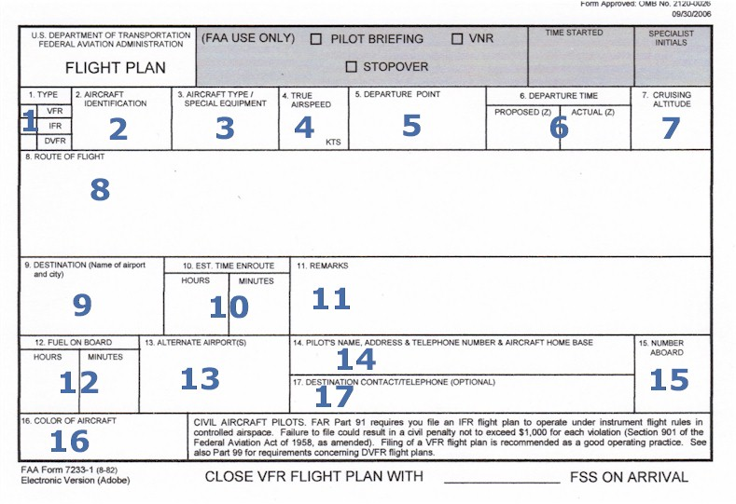
External Interfaces – Data Sources – Flight Plans

Slide 56
External Interfaces – Data Sources – Flight Plans – Cont.

Slide 57
External Interfaces – Data Sources – Flight Plans – Cont.
ATS message
Aeronautical Fixed Telecommunication Network (AFTN)
Serial link
Format check
ATS messages: Air Traffic Service
Logical check
TCP/IP link
Automatic Message Handling System (AMHS)
Flight Data Processor (FDP)
System Flight Plan

Slide 58

Flight Data Processing – Track/Flight Plan Correlation
◇
Sensory Data Processor (SDP)
◇
◻
Track Num. X
Location (lat-long)
Height
24-bit AC address
SSR Code
Call sign
◻
+
+
O
O
Corr.
Track #0
Track #0
Track #1
◇
◻
+
O
Corr.
Track #1
◇
◻
+
O
Track #2
◇
◻
+
Corr.
O
Track #2
◇
◻
+
O
System Flight Plan #Y
Airport DEP
Airport ARR
AC Type
Call sign
Est Time DEP
SSR Code
Track Num. X
Flight Plan Num. Y
Airport DEP
Airport ARR
AC Type
24-bit AC address
SSR Code
Call sign
Est Time DEP
Flight Data Processor (FDP)

Slide 59

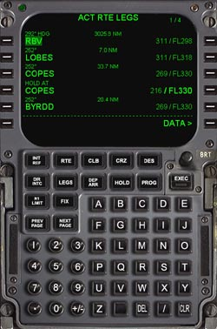
Flight Data Processing – SSR Code Allocation
Sensory Data Processor (SDP)
◇
Track Num. X
Location (lat-long)
Height
SSR Code
Call sign
ICAO Code
◻
+
O
Track #0
System Flight Plan #Y
Airport DEP
Airport ARR
AC Type
Call sign
Est Time DEP
SSR Code
Track Num. X
Flight Plan Num. Y
Airport DEP
Airport ARR
AC Type
SSR Code
Call sign
Est Time DEP
Allocated SSR codes
Retained SSR codes
Flight Data Processor (FDP)
SSR code pools

Slide 60

Flight Data Processing – 4D Trajectory Prediction
Aircraft data (BADA)
Flight Data Processor (FDP)
Current position of Aircraft
Weather data
Controller's clearances
Flight Plan
Path
...
Airspace structure (Routes)

Slide 61
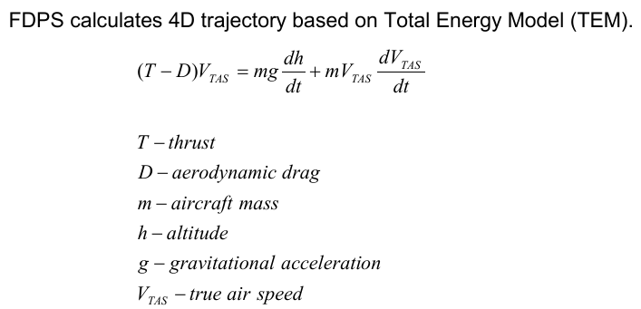
Flight Data Processing – 4D Trajectory Prediction – Cont.
Just for your knowledge

Slide 62

Safety Net
Safety Net

Slide 63
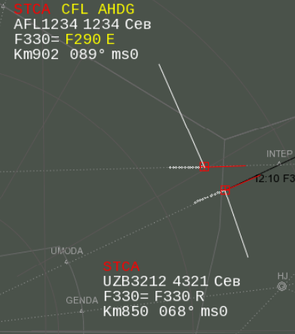


Safety Net - Short-Term Conflict Alert (STCA)
Alert of potential or actual infringement of separation minima
Short-Term Conflict Alert (STCA)
Min. separation: 2000 ft
FL290
Min. separation: 1000 ft
5 NM

Slide 64
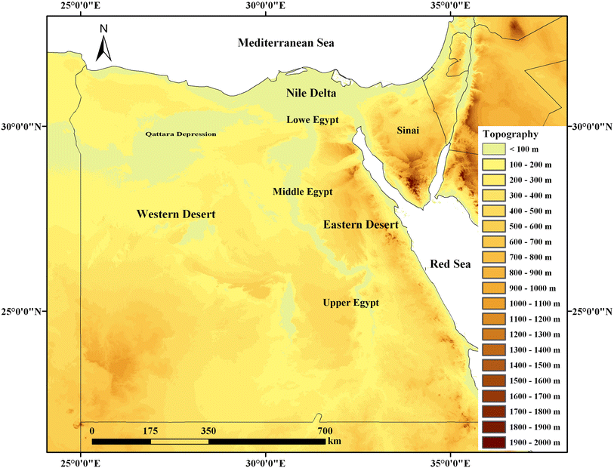
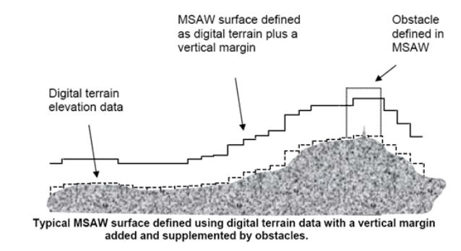
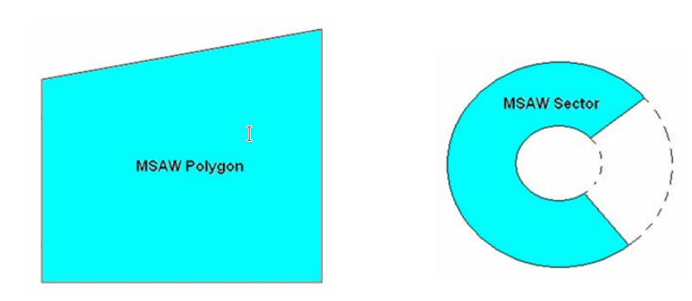
Safety Net - Minimum Safe Altitude Warning (MSAW)
Minimum Safe Altitude Warning
Digital Terrain Elevation Data (DTED)
Geometric Shapes

Slide 65
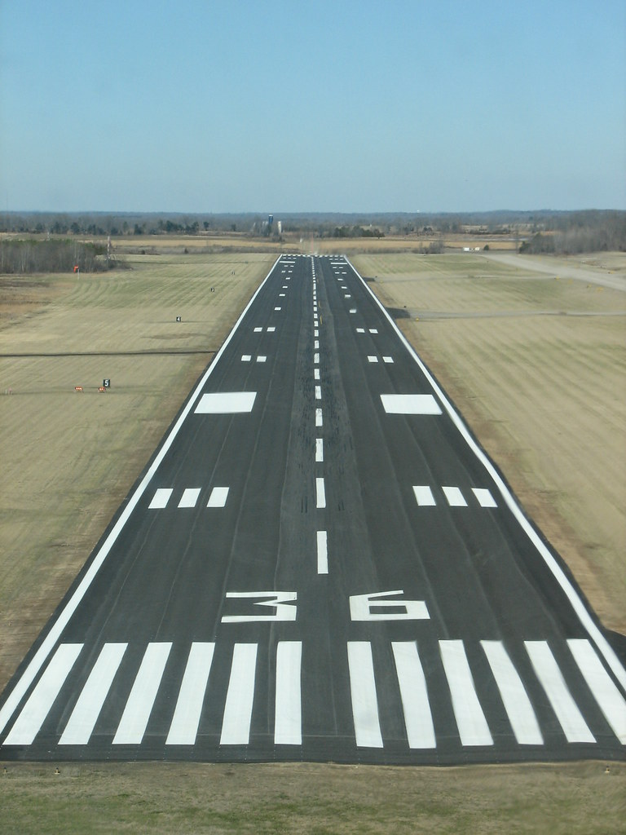
Safety Net – Approach Path Monitoring (APM)
Alerts for vertical and horizontal deviations from runways

Slide 66
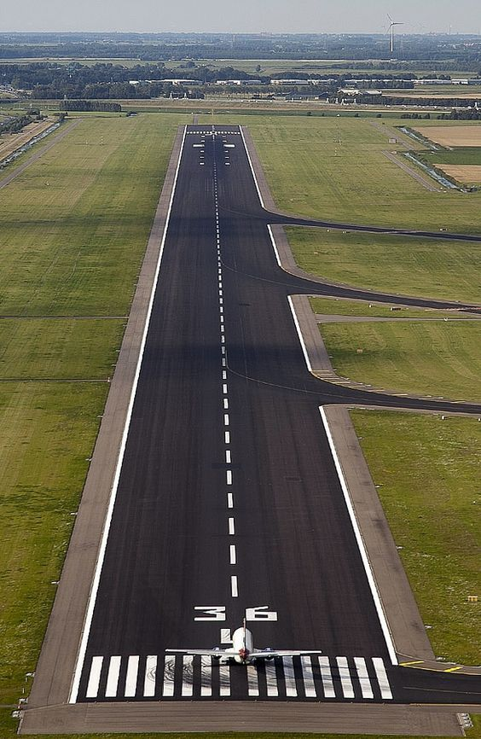
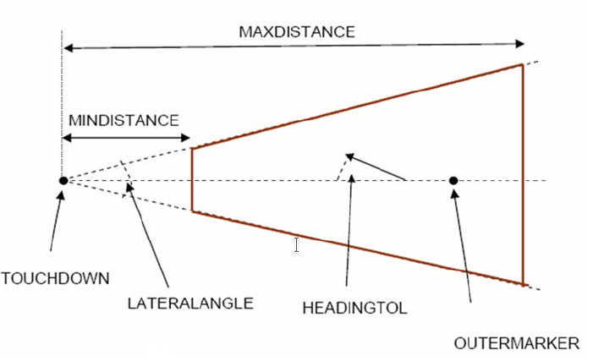
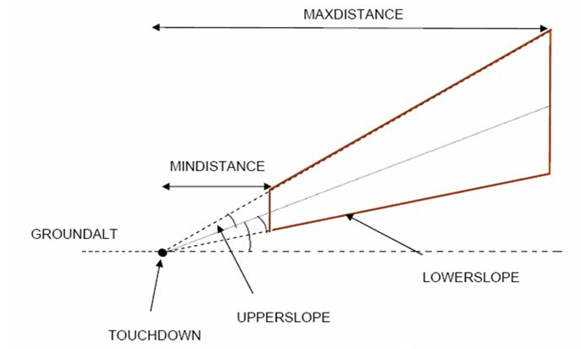
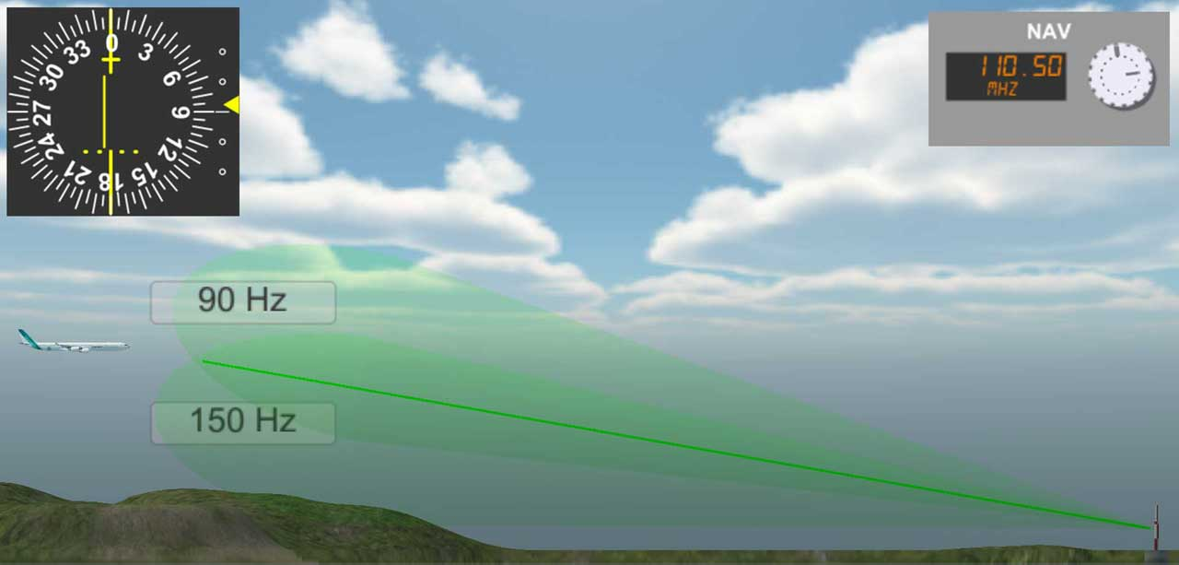

Safety Net – Approach Path Monitoring (APM) – Cont.
Glide deviation
Course deviation

Slide 67
Safety Net – Area Proximity Warning (APW)
Restricted Area
Military Aerobatic Area
Danger Area

Slide 68
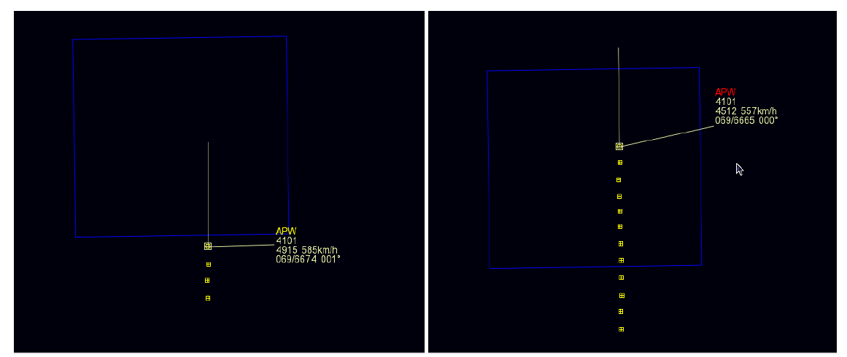
Safety Net – Area Proximity Warning (APW) – Cont.

Slide 69
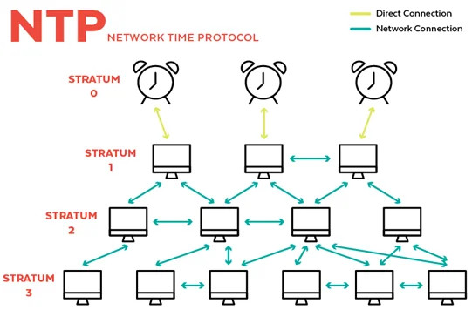
Other System Modules
Time Reference - Network Time Protocol (NTP)

Slide 70
Facts about Air Traffic Management
Phonetic letter code is used in the world of aviation (Activity)
MSR --> Mike – Sierra – Romeo

